Slide 1

Robotics Triathlon
By: Sarina Jones, Frank Illiano, Ehsan Salih

Slide 2
Challenges
Some of our challenges included:
The ability of the robot
The ability to meet as a group
Understanding a Systems design document
Learning to create a Gantt chart
Notes:
I say the ability of the robot because the code wouldn’t change but the measure would be very accurate sometimes and then really off the other times. I feel like every sprint has something to the consistency of aiming the robot. The robot also doesn’t measure distance

Slide 3
Roles of each team member
Sarina Jones
Frank Illiano
Ehsan Salih
Notes:
We all will just talk about what we did

Slide 4

What have we learned?
Block coding
Time Management
How to create a Gantt Chart
How to make a complete Systems Design Document
Groupwork
Creating an algorithm

Slide 5

What would you do differently
Better time management
Get together to work on the code more
Perfect the actions of the robot

Slide 6
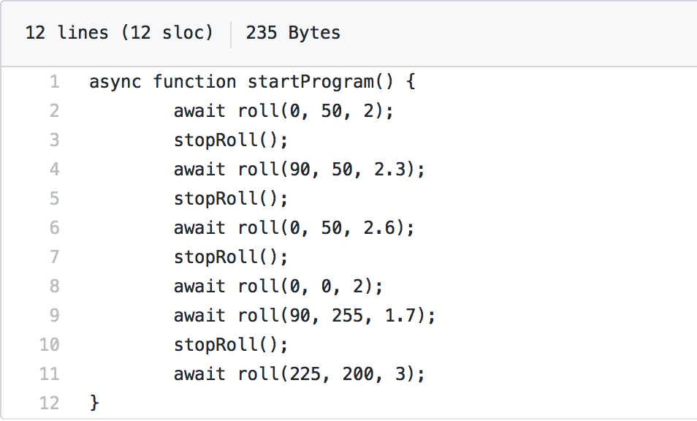
Code for Sprint 3 Agility

